Slide 1
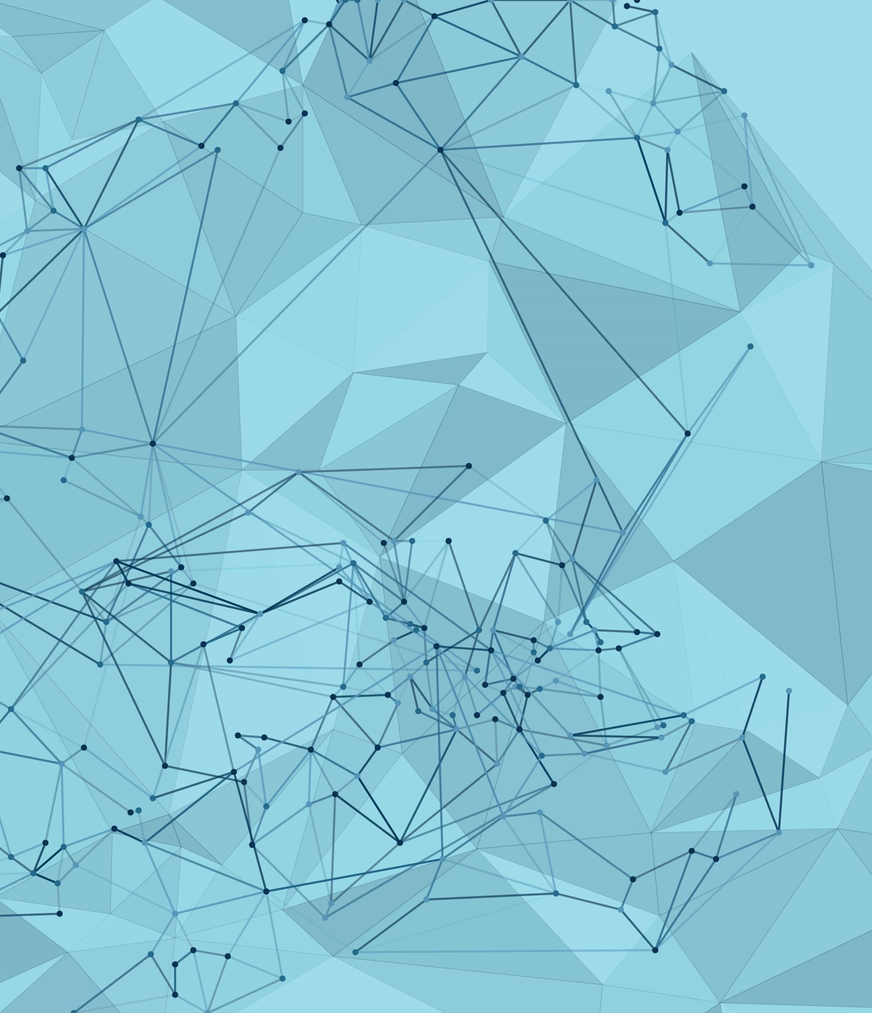

AI Project
Presented By:
Akhila Chinta
Professor:
Shivanjali Khare

Slide 2
Presentation Plan
AI Project
Project Objectives
Approach
Deliverables
Evaluation Methodoliges

Slide 3
AI Project Brain Tumour Detection
In the project there are many fascinating things out there therefore, I came up with a wide range of sectors, themes and subjects to work on for these AI project
I am very excited to project on brain tumour detection nowadays it has become a common problem in the society. Many people are suffering with this problem. I hope this AI technology helps doctors diagnose and treat brain tumours more accurately and quickly for making hope for patients.
A brain tumour is regarded as one of the more severe illnesses that can affect both adults and children. Eighty to ninety percent of primary cancers of the CNS are brain tumours.
Approximately 11700 people receive brain or central nervous system tumour. The 5-year survival rate is roughly 34% for males and 36% for women.
The AI helps in the noticing the what type of tumour it is and makes it easier to start treatment soon.

Slide 4
Project objectives:
Find a dataset
1
Find a model
2
Train the model on the dataset
3
Execute the model into the dataset
4
Discuss and show the results
5

Slide 5
Approach
In order to achieve autonomous brain tumor identification, we have opted to employ artificial intelligence (AI) through deep learning, or more specifically, an artificial neural network, or CNN.
A particular kind of artificial neural network used in image recognition and processing that is made especially to handle pixel data is called a convolutional neural network (CNN).
CNNs are highly effective artificial intelligence (AI) and image processing tools that use deep learning to accomplish both generative and descriptive tasks. They frequently use machine vision, which includes the recognition of images and videos.

Slide 6
Next, after the CNN is created, we will train it on the three data sets so that the model can differentiate between photos that are tumorous and those that are not.
Since the model would predict the data with 100% accuracy, it is inappropriate to test it on data that it has already seen. Instead, we can save the Test set for evaluating our model after the validation.
Following the preceding stage, we will test our model against the test set to see what kind of results we will obtain. Based on these results, we can then determine whether or not our model is good.

Slide 7
Deliverables
Data Set
Code in a Notebook
Screen shot for the execution
The Model after training

Slide 8
Evaluation Methodology
To start, we use CNN to show our model, which only has a few completely connected layers.
• We list all of the model's parameters in detail.
Next, we begin training our model. Once training is complete, we assess our model to see whether it is a good model or need improvement.
To assess the model's accuracy, we search for a larger dataset, determine whether it is good or bad, and make any necessary improvements.

Slide 9
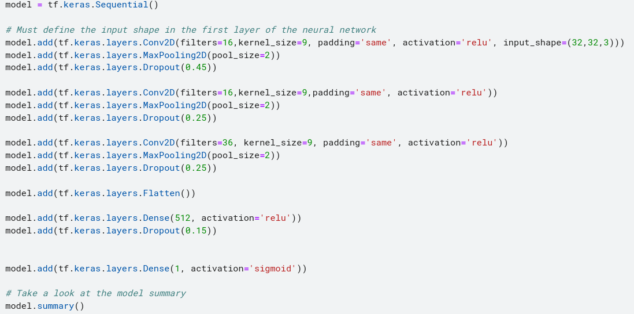
Here is the following model that created via CNN with fully connected layers.

Slide 10
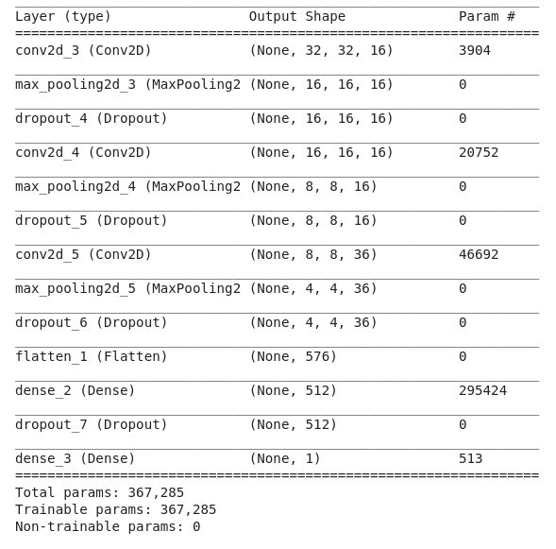
And here is the result for the model summary that shows our model in detail and specifies the total parameters of the model

Slide 11
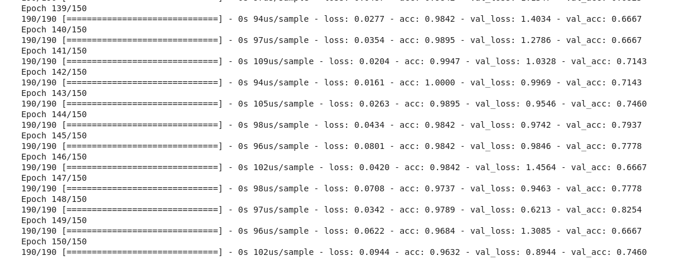
Then we start train our model for 190 epochs just as shown in the figure below

Slide 12
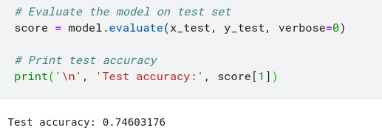
After we finish training our model we now go to the part where we evaluate our model to see if it's a good model or if it needs improvements.
As we can see the accuracy of our model is at 74.6% it is not that bad but its good and we can still improve this result by looking for a bigger DATASET

Slide 13
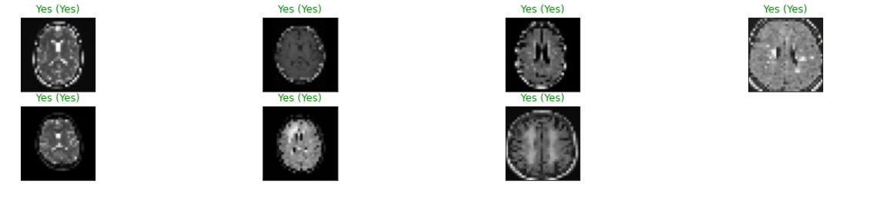
And here are some results for the model when we run it on the test pictures
Between the brackets is the correct prediction so we can say that our model gave pretty much good results.

Slide 14
Conclusion:
This research combined a computer vision problem (automating the process of brain cropping from MRI data) with a CNN model classification challenge (predicting if the subject has a brain tumour or not).
Final accuracy exceeds 50% baseline (random guess) by a large margin. On the other hand, it might be raised by using more training photos or by adjusting the model's hyperparameters.

Slide 15
Thank You

